Slide 1
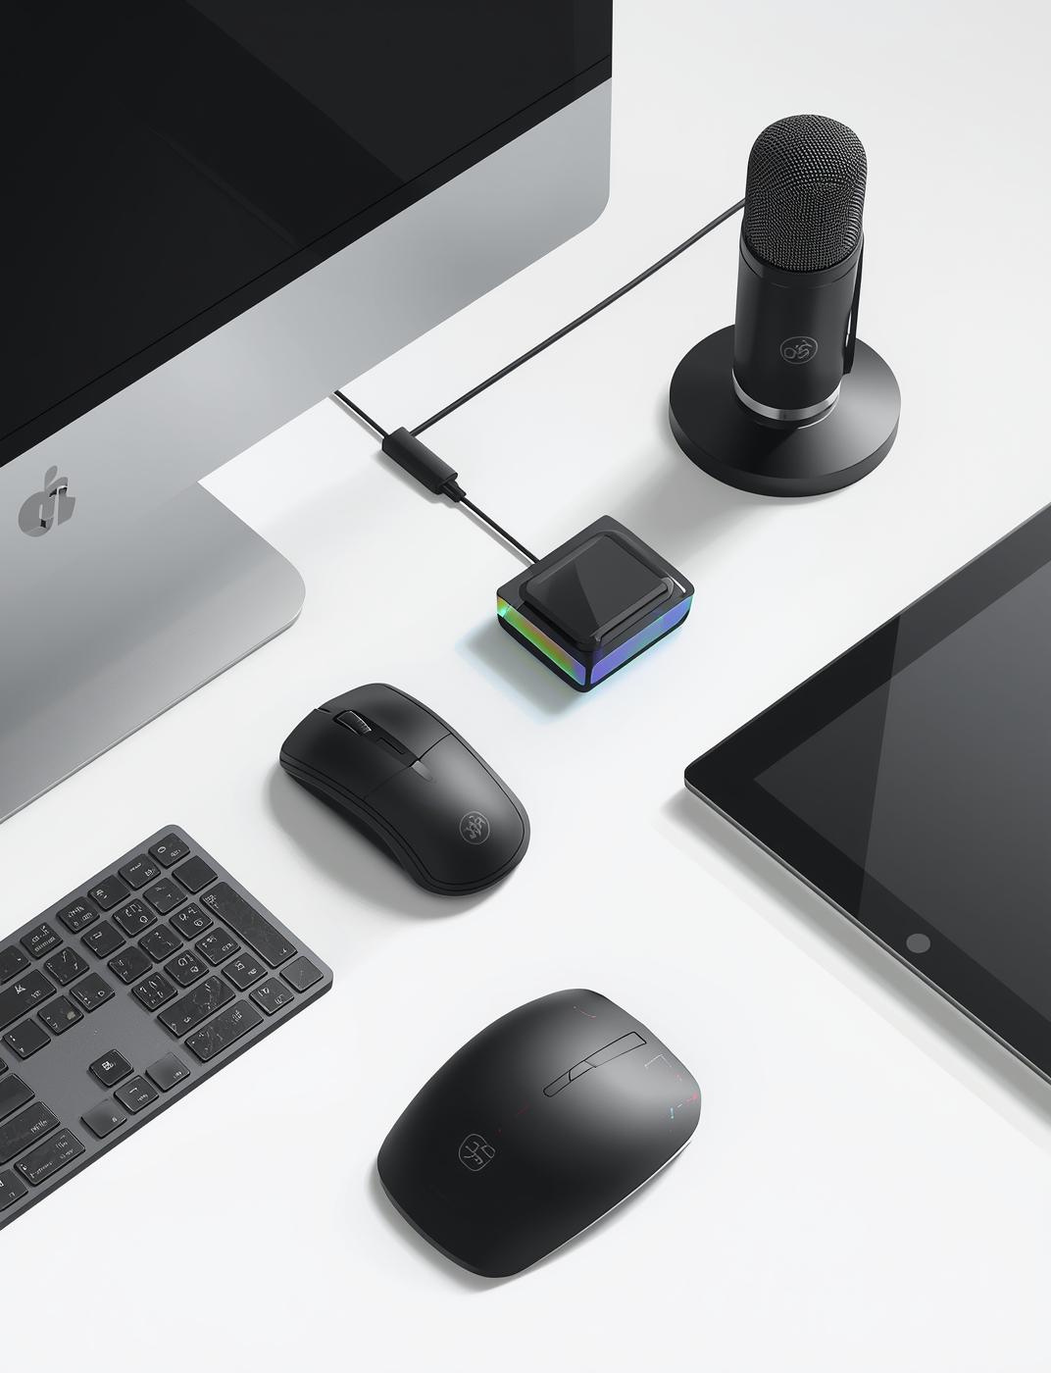
Input Devices in Computer Systems
An Overview of Input Devices
Hana Aden
Seofch Acedamy

Slide 2


Introduction to Input Devices

Slide 3


Defining Input Devices
Input devices are essential hardware tools that enable users to enter data and instructions into computers, facilitating interaction and communication with digital systems.

Slide 4
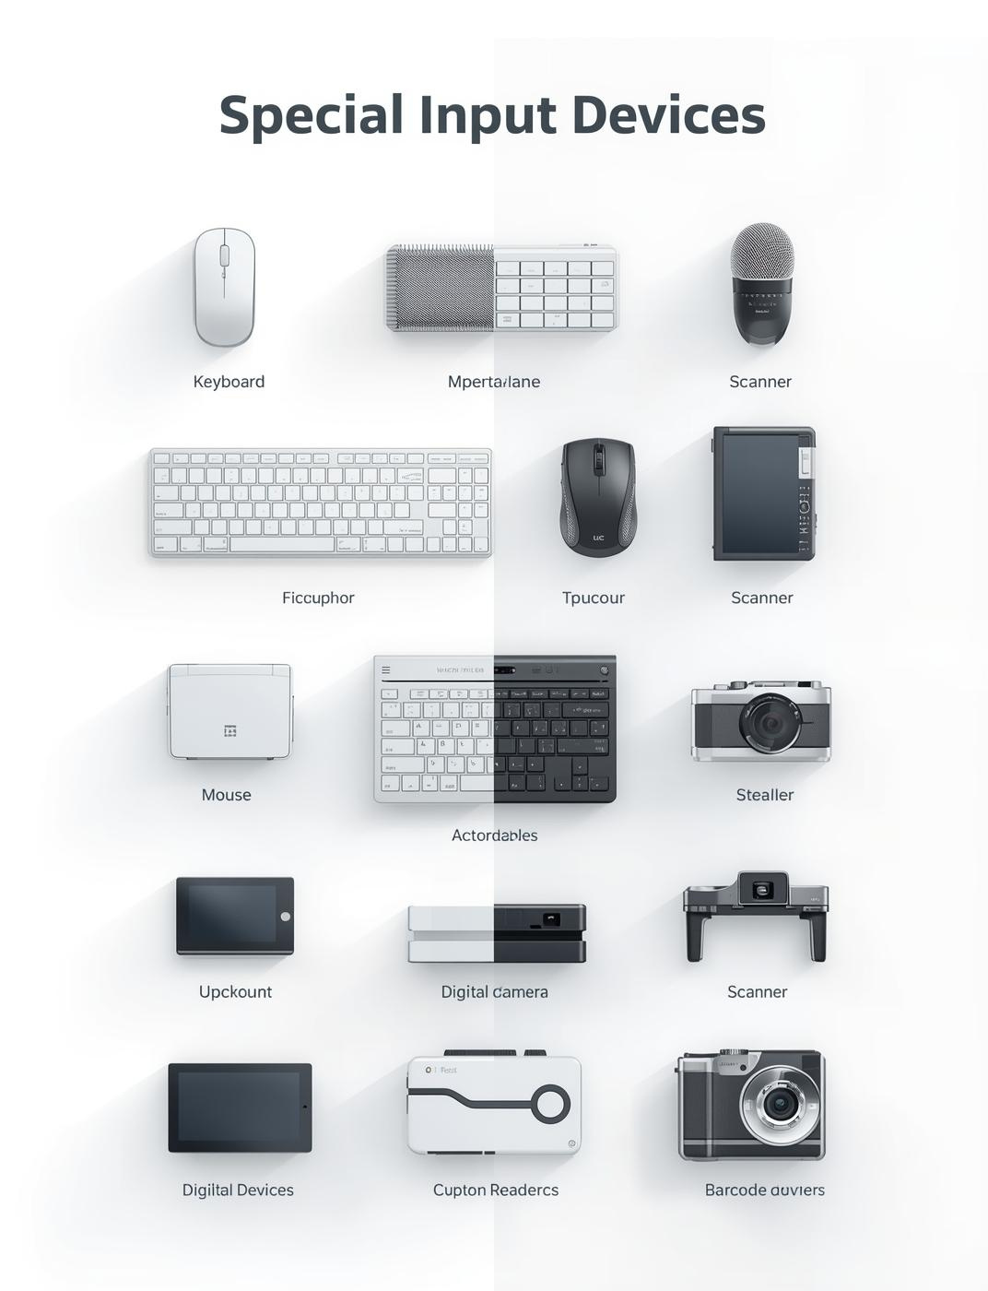
Classification of Input Devices

Slide 5
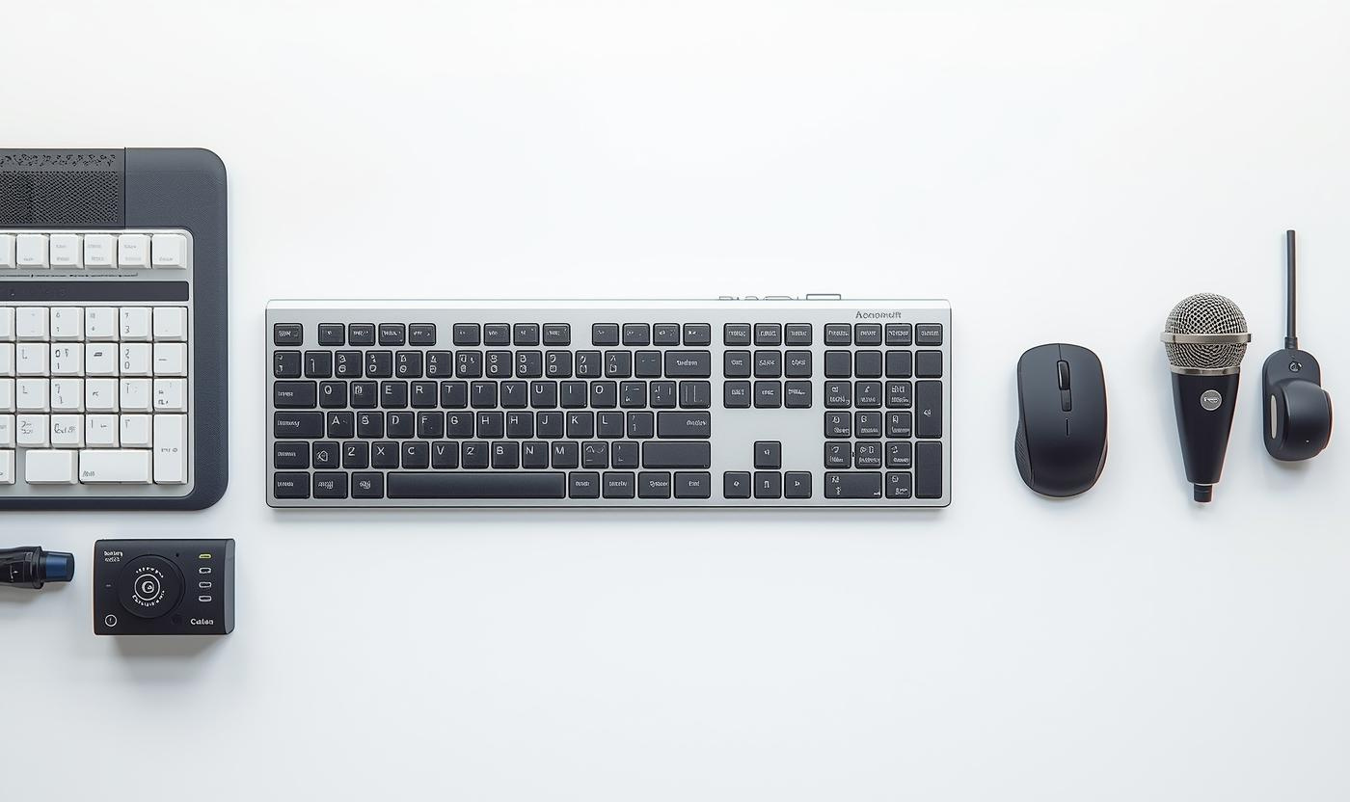
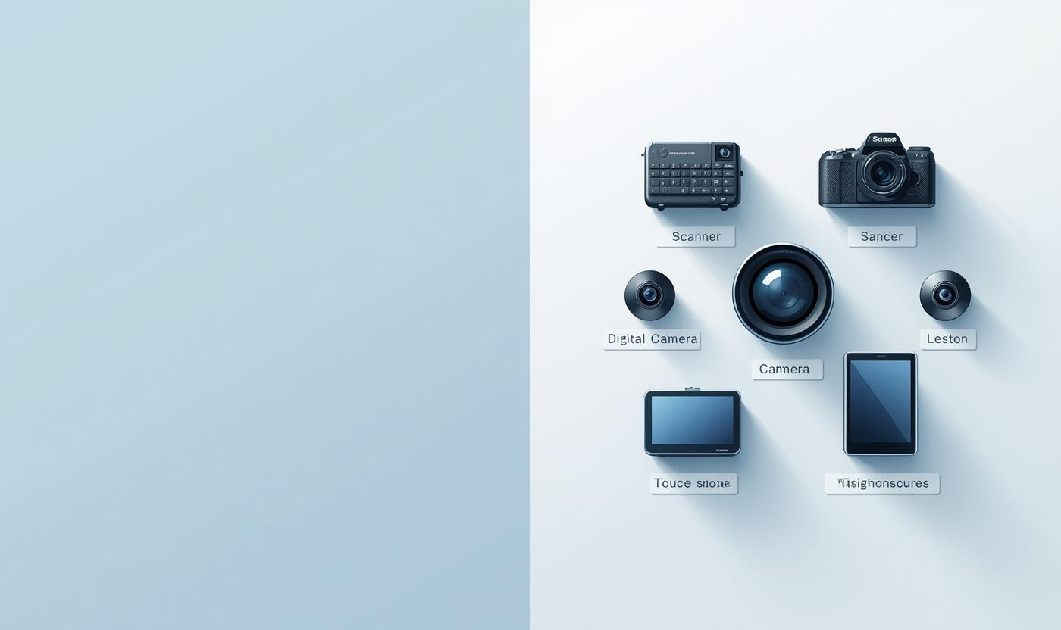
Basic vs Special Devices
This section contrasts basic input devices, essential for standard computer operations, with special input devices, which enhance functionality for specific tasks, showcasing their importance in computing.

Slide 6
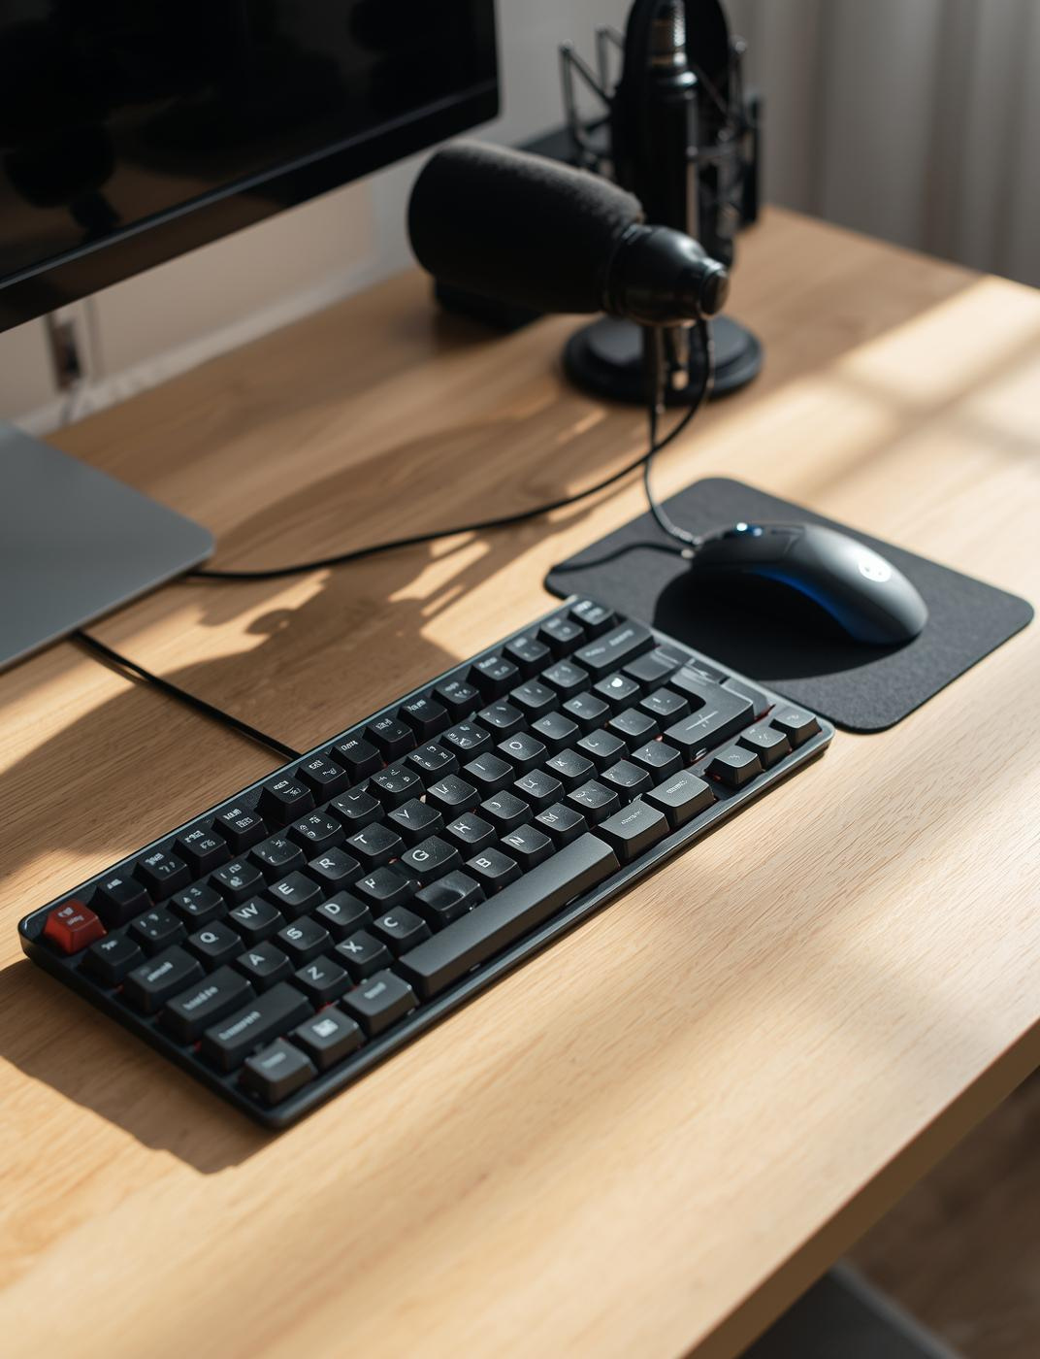
Basic Input Devices

Slide 7
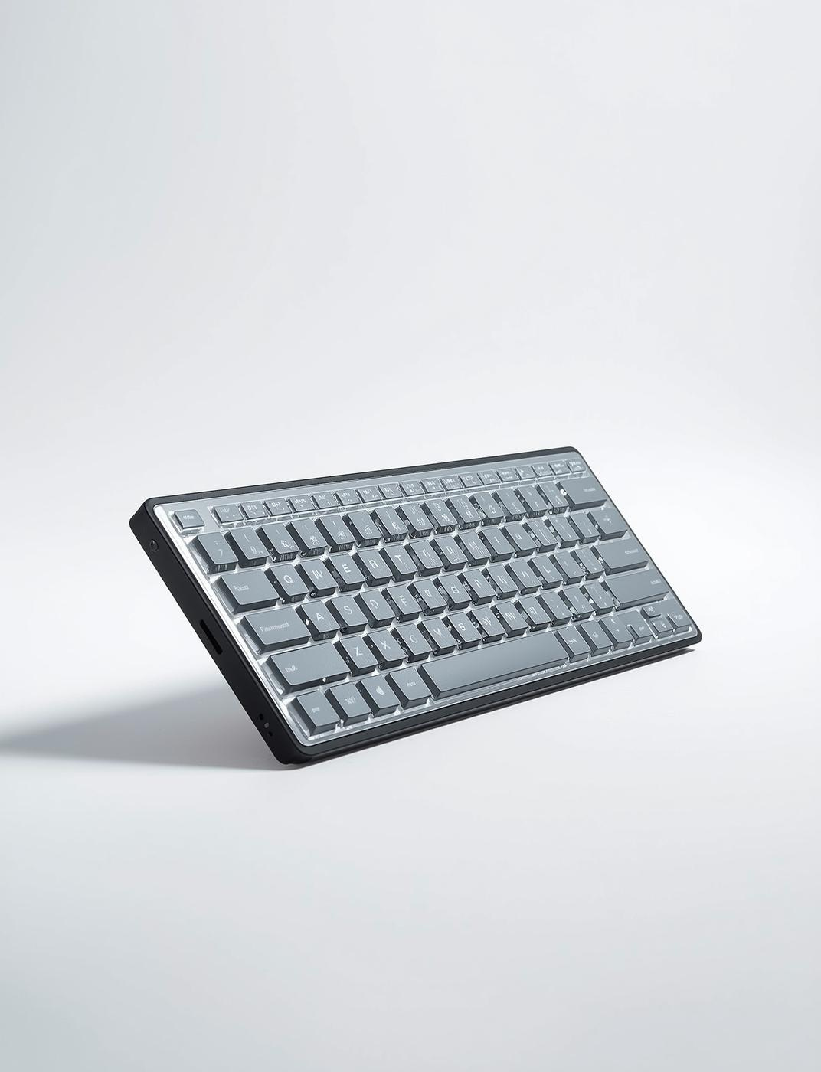
Computer Keyboard
The keyboard serves as the main input device for text entry in computing. Its QWERTY layout facilitates efficient typing, featuring various key categories for diverse functions.

Slide 8
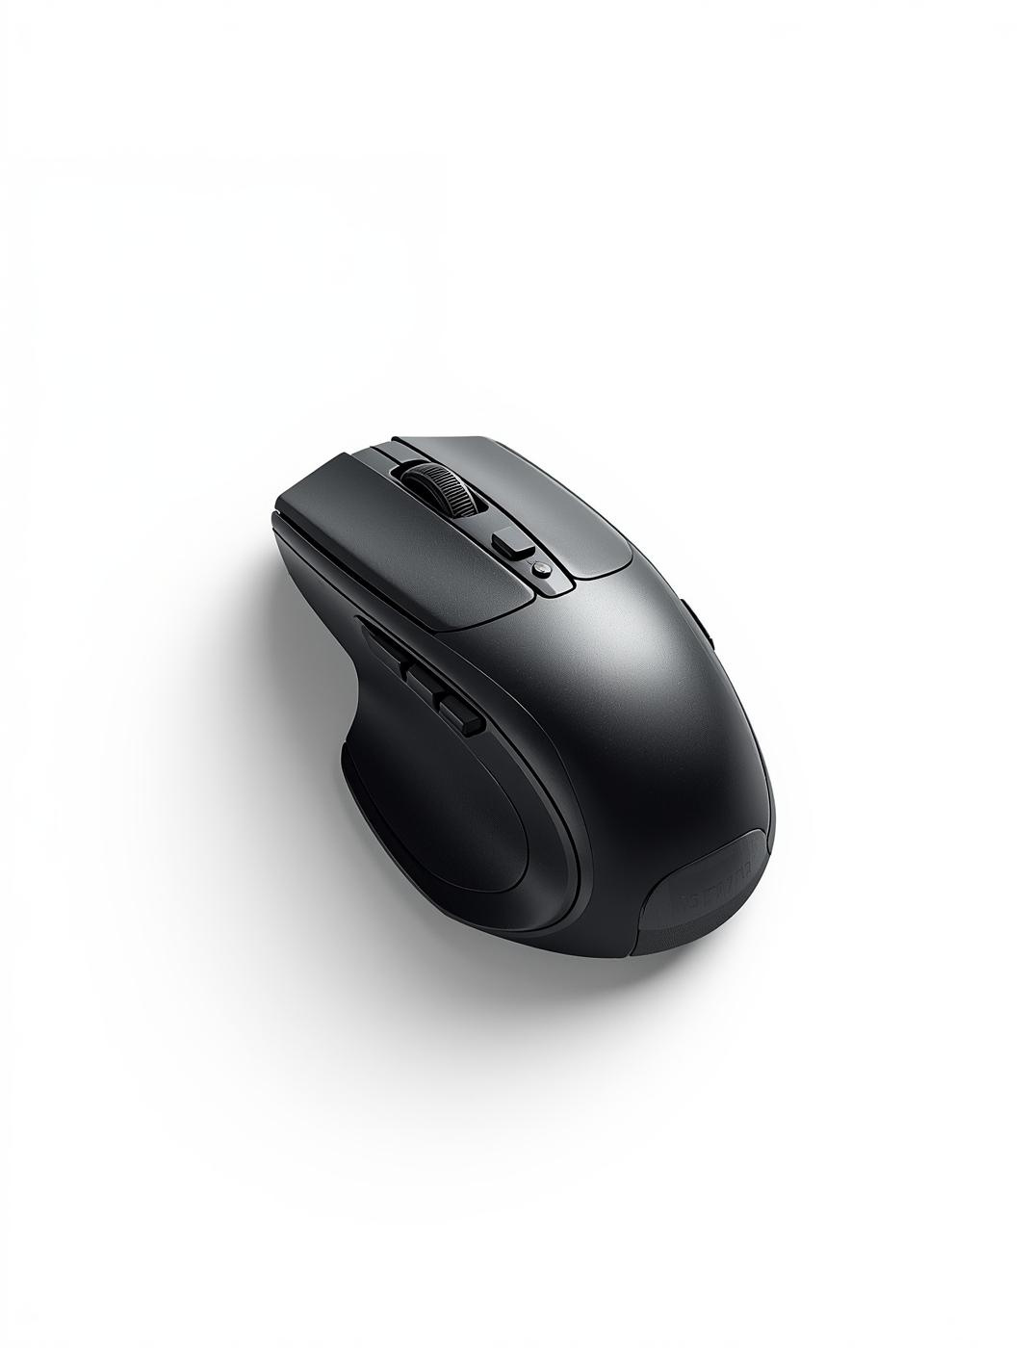
Ergonomic Computer Mouse
An ergonomic computer mouse is designed for comfort and efficiency. It allows users to navigate their screens effortlessly while reducing strain on the wrist during prolonged use.

Slide 9

Microphone
The microphone is a key input device for capturing audio. It converts sound waves into electrical signals for processing, making it essential for recordings, voice commands, and communication.

Slide 10
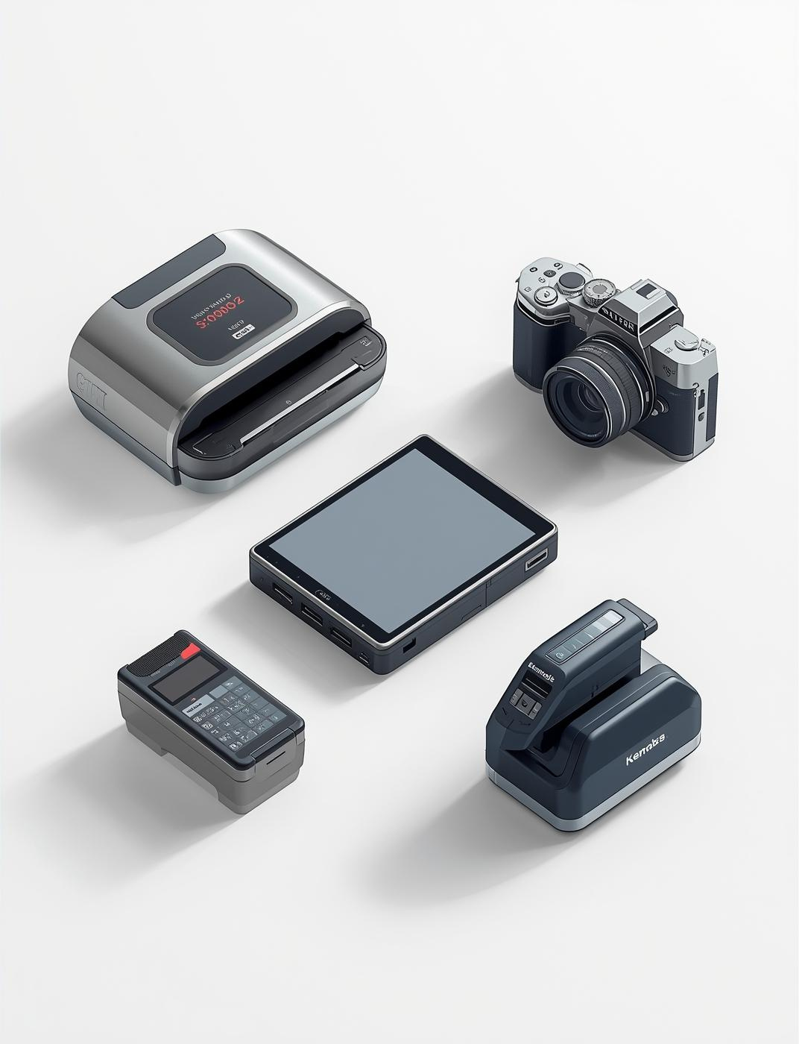
Special Input Devices

Slide 11

Scanner Device
A scanner is an essential input device that converts physical documents into digital images. It enables easy storage and editing of documents for computer processing.

Slide 12
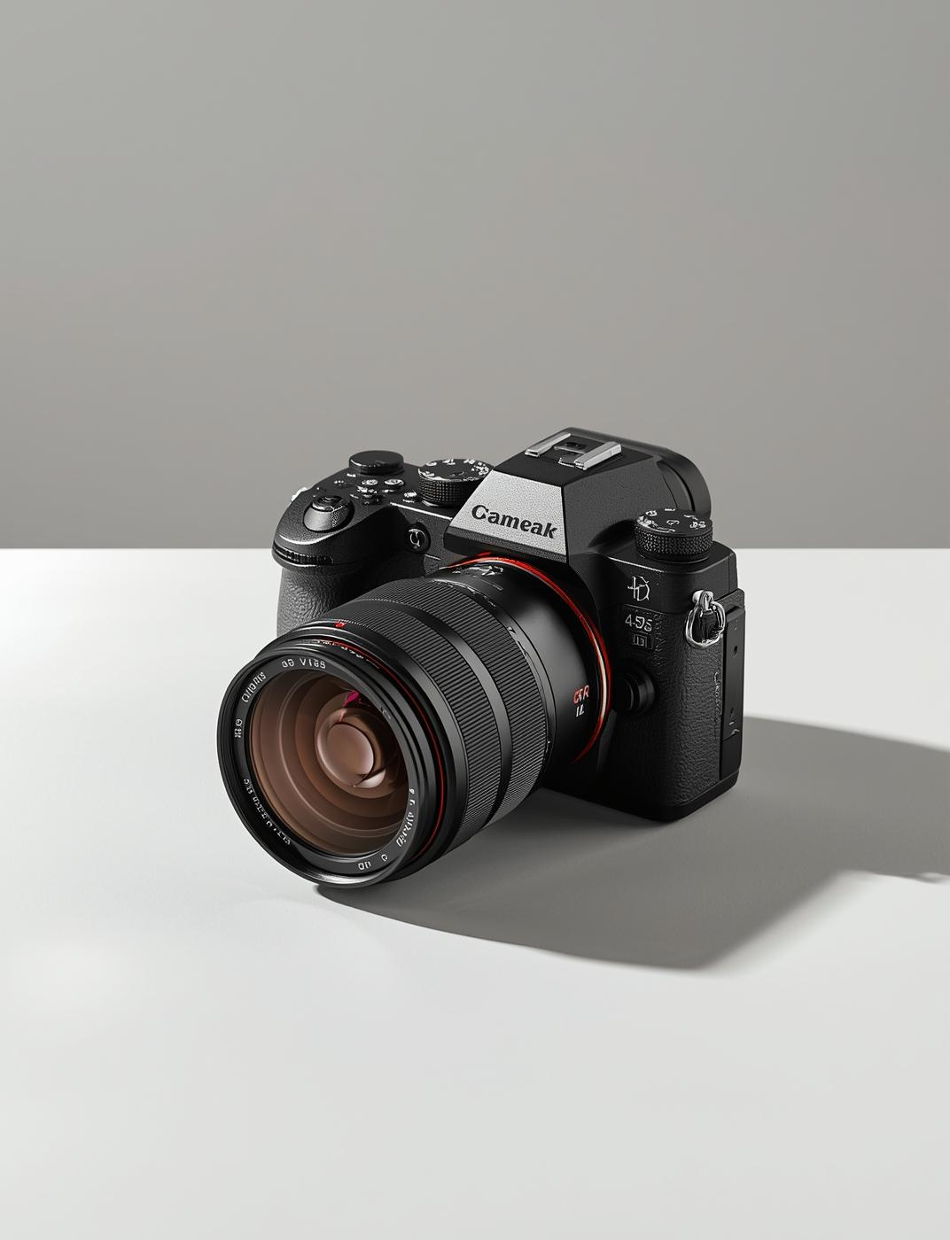
Digital Camera
A digital camera captures high-quality photos and videos, allowing for versatile input to computers. It enables users to document moments and share experiences efficiently.

Slide 13

Touch Screen Technology
Touch screens provide an interactive interface where users can directly manipulate content through taps and swipes, enhancing usability and accessibility in various applications.

Slide 14
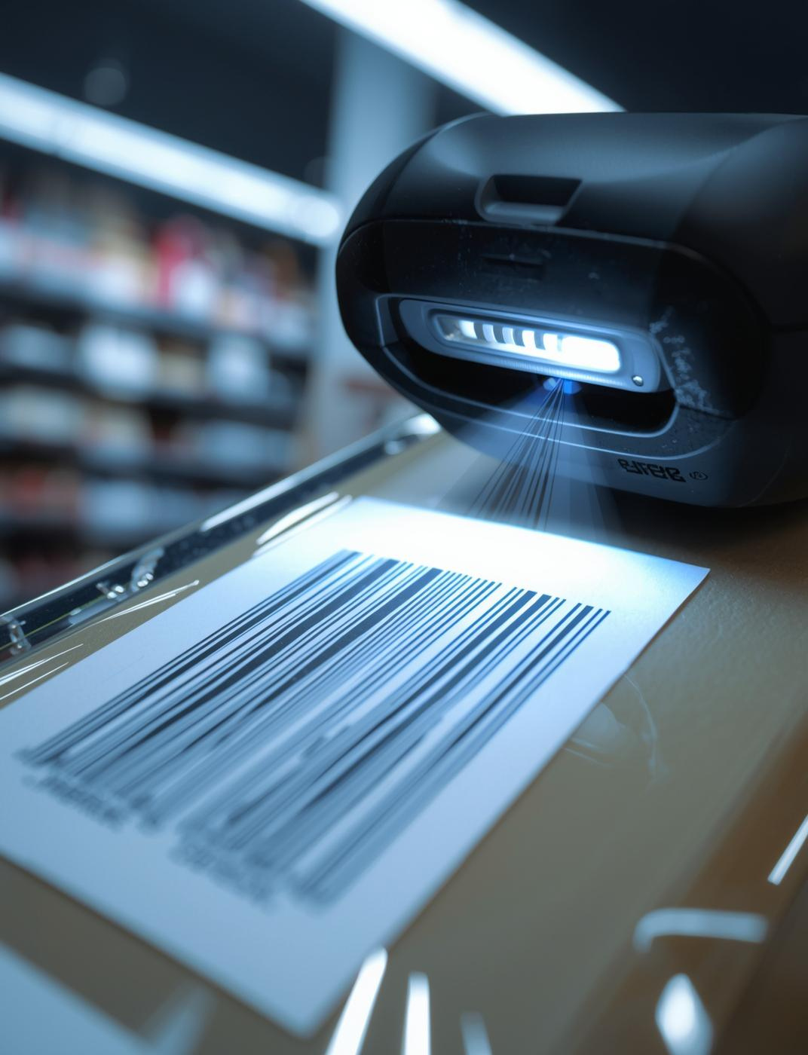
Barcode Readers
Barcode readers are essential for automated data capture, allowing quick scanning of products. They facilitate efficient inventory management and checkout processes in retail environments, enhancing productivity.

Slide 15


Keyboard Functions and Types

Slide 16

Keyboard Key Categories
Numeric Keys
Used for entering numerical data efficiently and quickly.
Understanding different types of keyboard keys
Alphabetic Keys
Essential for typing letters and forming written content.
Mathematical Keys
Facilitate basic calculations and mathematical operations easily.
Function Keys
Provide shortcuts for software commands and functions effectively.

Slide 17

Types of Keyboards
Types of Keys on a Keyboard
(a) Numeric Keys
Keys numbered from 0 to 9 are called numeric keys and are used to enter numbers.
(b) Alphabetic Keys
Keys labeled A to Z are alphabetic keys and are used to type letters.
(c) Mathematical Keys
Keys with symbols such as +, −, ×, ÷, =, %, <, >, { }, [ ], and ( ) are mathematical keys used for calculations.

Slide 18

d) Numeric Keypad
The numeric keypad is located on the right side of the keyboard and allows fast numeric entry.
(e) Function Keys
Function keys (F1 to F12) are located at the top of the keyboard and perform special tasks depending on the software being used.
(f) Special Keys
Special keys include Enter, Shift, Ctrl, Alt, Esc, Tab, Caps Lock, Backspace, Spacebar, Insert, Delete, and Print Screen.
Conclusion
In summary, input devices are essential for effective computer interaction. They enhance user experience and enable diverse functionalities, making technology more accessible and efficient for everyone.

